Slide 1


NAME: Matt Yemma, Founder DATE: MAY - 2025

Slide 2

WHO WE ARE
Endeavor Communications is an independent marketing communications firm that provides innovative and impactful solutions to private and public clients in global capital markets, legal, alternative and traditional asset management, fintech, climate/ESG, Blockchain/crypto, and financial and professional services.
Endeavor offers a mix of public relations strategy, media relations, and content development & writing.
Endeavor Communications provides integrated and strategic communications from program strategy through execution. We put our clients first and measure our performance based on our client's success.

Slide 3
SERVICES
ENDEAVOR COMMUNICATIONS OVERVIEW
Endeavor Communications offers a diverse range of services to meet the needs of clients in various industries. These services encompass strategic planning, coordinated execution, to results oriented measurement.
Communications Strategy
Content Development
Content Marketing
Expert Sourcing
Media Relations
Media Training
Thought Leadership Programs
Transaction Support
Crisis Communications
Digital Strategy
Issues Advocacy
Launches; Fund Launches, Company Launches
Media Events
Media Research & Audits
Program Evaluation & Analysis
Social Media Strategies

Slide 4















CLIENT EXPERIENCE

Slide 5

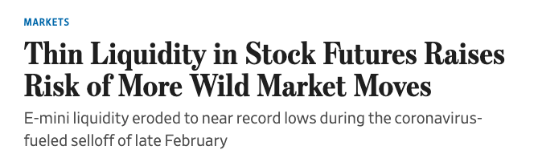
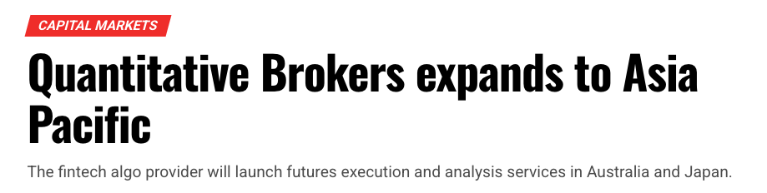
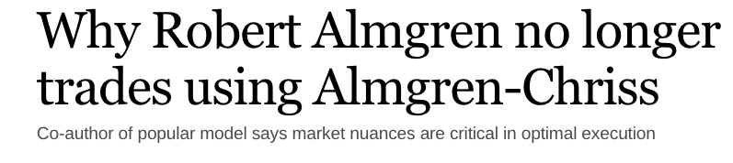
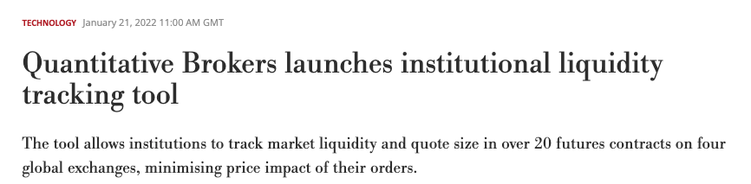
CASE STUDY
ENDEAVOR COMMUNICATIONS OVERVIEW
Quantitative Brokers – Sustained media relations for one of Wall Streets top providers of market data
In 2022, Quantitative Brokers, a top provider of trading data and algorithmic execution for many of Wall Street’s top banks and hedge funds, hired Matt Yemma and Peaks Strategies to help the company build a better brand name
Through sustained media relations, including creative ideas such as weekly ”lunch and learn” sessions with QB’s top execs, where we would bring in targeted reporters for a 1-1 meeting with QB execs, offer them lunch, and open the floor to all questions. These proved to be very popular.
Newsjacking certain items and placing QB data, and executives in top tier and targeted publications
Expanded QB’s presence in Asia – assisted with market launches in APACA countries including Japan, Australia, Malaysia, Hong Kong, and more.
Working directly with QB Head of Research to place QB data
Media Highlights: ”Lunch & Learn” sessions with reporters from The Wall Street Journal, The Desk, Reuters News, Business Insider, and Bloomberg News. Placements of QB data and QB executive commentary in targeted media, including NPR, The Wall Street Journal, and many more. Placements in foreigh media, including Nikkei, Japan, and many others.
Executive Visibility: Created brand visibility for Founder and Chief Scientist Dr Robert Almgren, for Founder and CEO Christien Hauff, and Head of Research.
5
Notes:
Matt

Slide 6
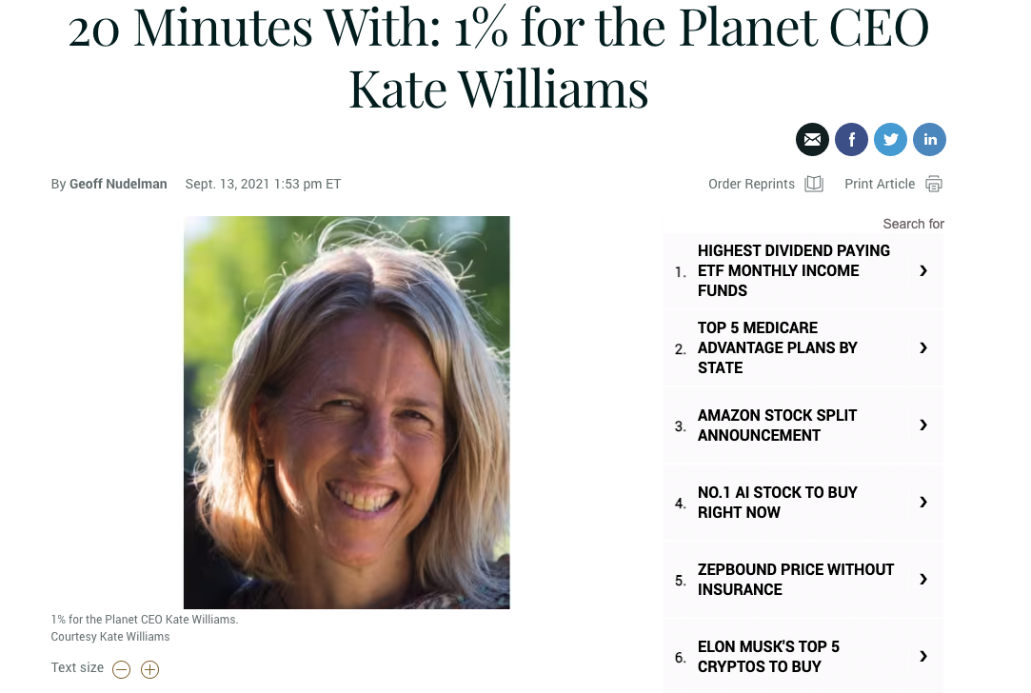

CASE STUDY
ENDEAVOR COMMUNICATIONS OVERVIEW
1% for the Planet – Launching the Planet Impact Donor Advised Fund (DAF)
In 2022, Burlington, VT based global nonprofit 1% for the Planet hired Matt Yemma & Peaks Strategies to assist with the strategy and launch of their “Planet Impact Fund.”
The fund was launched with an exclusive story in Fast Company.
Media Highlights: Cover story in Fast Company on Planet Impact Fund launch. Continued top tier media hits on relevant topics for CEO Kate Williams, including climate disasters, philanthropic giving, etc… Kate has been featured on CNN, Barron’s, Sustainable Brands, and many more. Also provided media support for on-going 1% for the Planet’s annual Global Summit.
Executive Visibility: Created brand visibility for CEO Kate Williams as an expert in the field of philanthropic giving, disaster relief, climate adaptability and resilient communities.
Strategic Messaging: Working with CEO Kate Williams, we developed a strategic message around 1% for the Planet’s fundraising and development goals.
Results
345
media engagements garnered under contract for 1% in 2021-2024
5
Notes:
Matt

Slide 7

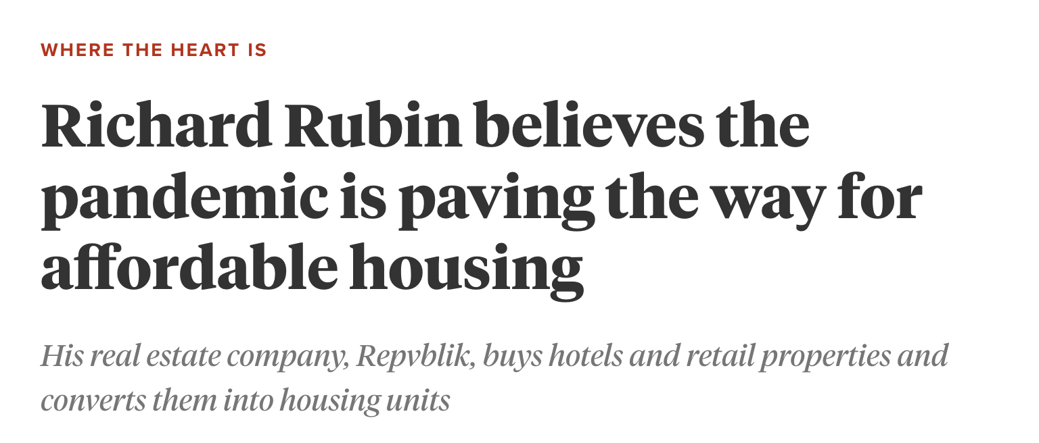
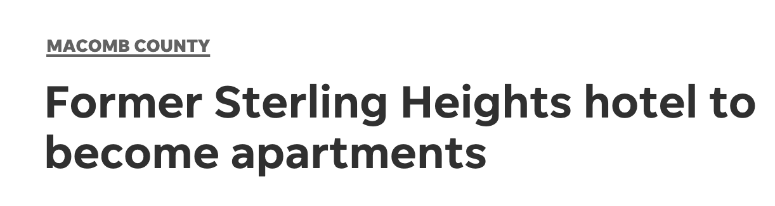
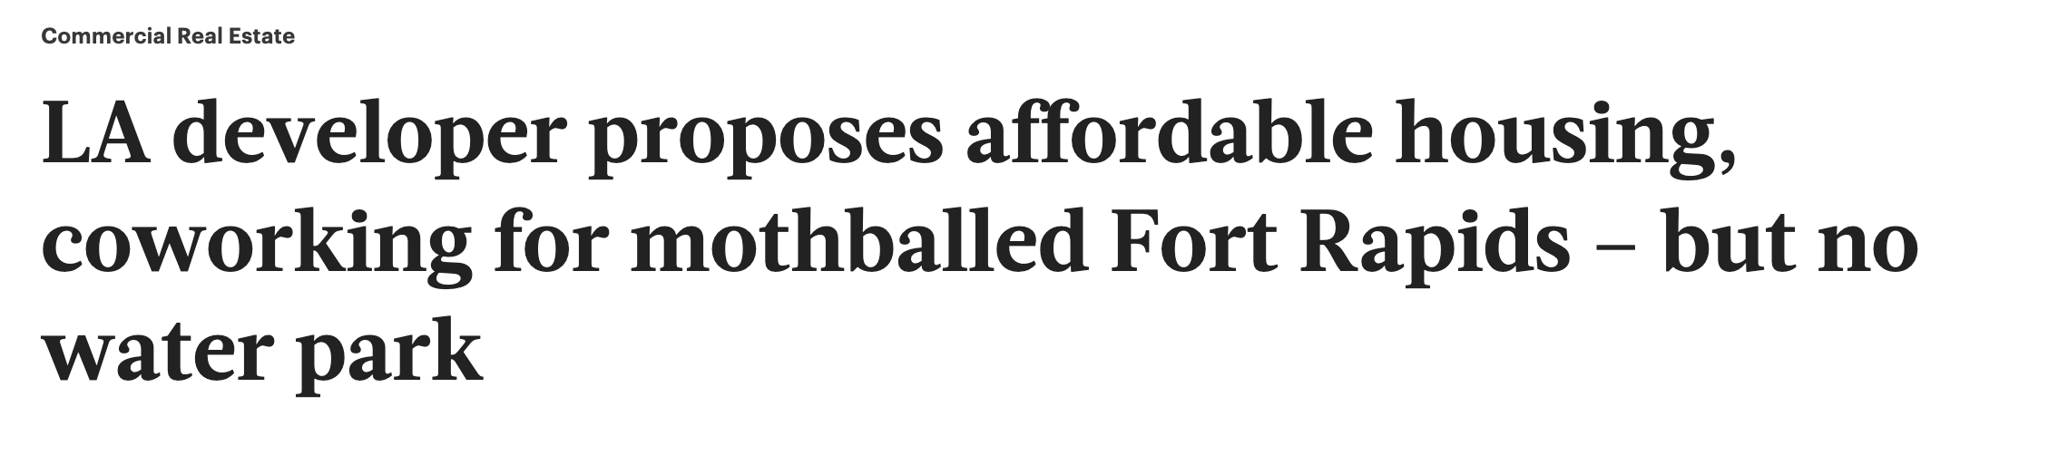
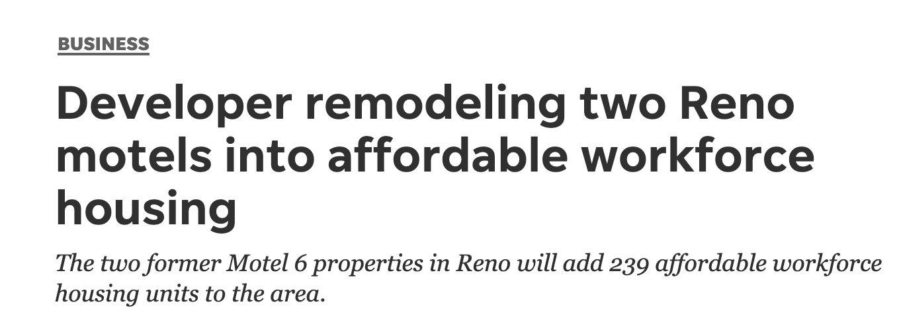
CASE STUDY
ENDEAVOR COMMUNICATIONS OVERVIEW
Repvblik– Adaptive Reuse of Empty Commercial Buildings/Properties
In 2020, Repvblik contracted Matt Yemma and Peaks Strategies to promote their image as a leader in the adaptive reuse space in commercial real estate.
Through a multipronged media campaign that included, print, TV, and original content, Repvblik quickly grew their brand name and garnered in-bound leads from the media placements.
Repvblik CEO was placed in numerous publications, including, Yahoo TV, Fast Company, Multi-Housing News, and many more.
Worked to coordinate acquisitions of properties, as well as key moments, I.e. construction completed, lease up, etc…In numerous states around the US, including Michigan, Texas, Oklahoma, and California.
“Every lead I get is thanks to you guys,” Richard Rubin, Repvblik CEO
Media Highlights: Top Tier placements targeted to the commercial real estate space, in promoting the idea of adaptive reuse. Successful rollouts of properties across the US in numerous states. Repvblik and Rubin have become well known names in the adaptive reuse space.
5
Notes:
Matt

Slide 8




CASE STUDY
Four Twenty Seven (427) – Building to a market leading acquisition
In 2017 Berkeley, CA based Four Twenty Seven, a provider of climate risk intelligence and data, hired Matt Yemma to provide public relations services related to raising the visibility of the company.
427 was correctly positioned as an industry leader in climate risk and intelligence, resulting in interest from Moody’s, which acquired the firm in 2019 and made it part of Moody’s Global ESG Practice.
Media Highlights: Cover story in Barron’s, Profile story in The Bond Buyer, Partnership with The New York Times using 427 data, constant 427 analysis and comments on on-going climate events, political developments, and international events related to climate.
Executive Visibility: Elevated Founder & CEO Emilie Mazzacurati as an expert in the field of climate risk & intelligence
Strategic Messaging: By understanding the analysis 427 could offer, we correctly plugged them into ongoing stories or members of the media who would find their work of interest.

Slide 9
Thank you!
Contact:
Matt Yemma
Founder
909-633-9396
matthew@endeavorcomms.com

